Slide 1
Chapter 5
Advanced Query

Slide 2
Review
Review of User and Security Management:
  Login management
  User management
  System Stored procedures for login and user management
  Granting and revoking permissions

Slide 3
Objectives
Explain and implement subqueries
Explain the use of EXISTS clause
Explain how to perform queries
Make use of the DISTINCT clause to filter query results
Explain the use of COMPUTE BY
Pass data between tables using SELECT INTO

Slide 4

What is a Query?
A request or a
question regarding
Query
Data in Tables
Initiates
Processed by
SQL Server
Answers the query – returns the result set
User

Slide 5
‘Select’ statement in a Query
Retrieves rows and columns
May include more than one table or more than one database.
Defines the columns required by the query as a series of expressions.
Resulting columns are in the same order as in the query.

Slide 6



Querying Multiple Tables
There are 3 ways to combine data from multiple tables:
- Unions: Combine rows from multiple data tables
- Subqueries - Subquery is encapsulation of one query inside another query
- Joins - Joins combine columns from multiple data tables

Slide 7
Subqueries
Subquery : one SELECT statement is nested inside another SELECT statement
Parent Query
Select <Column Name> From Table
Operator
WHERE <Column Name> =
Select <Column Name> From <Table> WHERE <Column> = <Criteria >
Subquery

Slide 8


Using EXISTS and NOT EXISTS
It functions as an existence test.
EXISTS is used to check the existence of rows returned by the subquery
The subquery does not actually return any data, it returns TRUE or FALSE

Slide 9
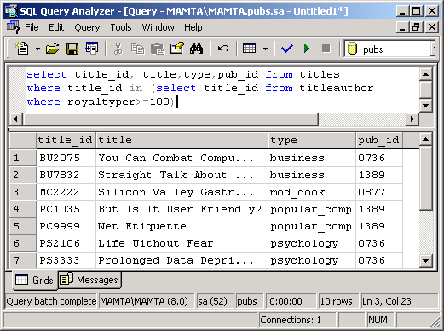
Nested Subqueries
Nested Subqueries are queries within subqueries
Example
Nested
upto
2 levels

Slide 10
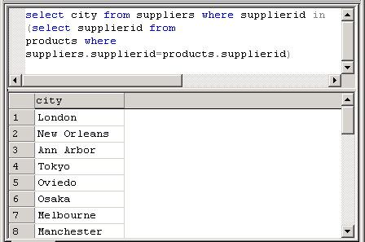
Correlated Subqueries
  Subquery refers to the parent query
  Subquery is re-evaluated for every iteration of parent query.
Example

Slide 11
Unions
Union operator : Combines two or more SELECT statements into a single result set
Union is specified as
SELECT statement UNION [ALL] SELECT statement
ALL clause does not remove duplicates

Slide 12
Unions Contd…
Each select must have the same structure
compatible column types and same number of columns
Example:
SELECT empno, ename, sal FROM emp
UNION
SELECT empno, ename, sal FROM ret_emp

Slide 13
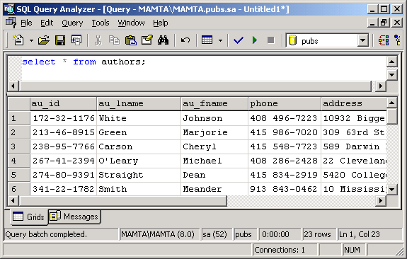
Querying all rows
Example

Slide 14
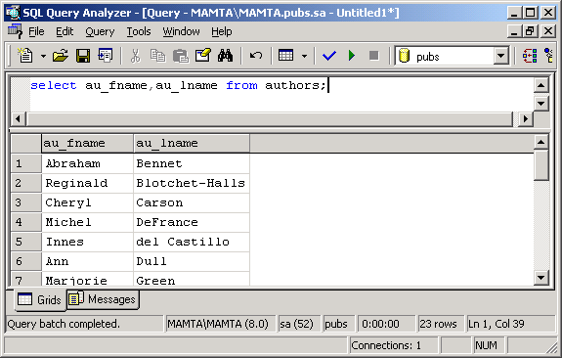
Choosing selected columns
Example

Slide 15
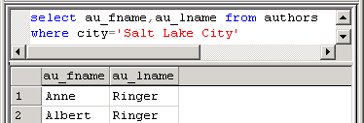
Using WHERE clause with SELECT
The optional WHERE clause in a query acts as a filter to limit the number of rows returned based on the specified condition.
Syntax: SELECT <Column Name> FROM <table Name> WHERE <Condition>
Example

Slide 16
Relational Operators and the WHERE clause
We can use different kinds of search conditions and
comparison operators when constructing a WHERE
clause. The following table lists the different
comparison operators that can be used in a query.
Operator
Meaning
=
Equal to
>
Greater than
<
Less than
>=
Greater than or equal to
<=
Less than or Equal to
<>
Not equal to
!
Not

Slide 17
Wildcard characters and LIKE
Wildcard
Description
Example
‘_’
A single character
Select Branch_Code From Branch Where Branch_Code Like ‘L__’
%
A string of any length
Select Route_Code From FlightSchedule Where Route_Code Like ‘AMS-%’
[]
A single character within the range enclosed in the brackets
Select Airbusno From FlightSchedule Where Airbusno Like ‘AB0[1-5]’
[^]
Any single character not within the range enclosed in the brackets
Select Airbusno From FlightSchedule Where Airbusno Like ‘AB0[^1-5]’

Slide 18
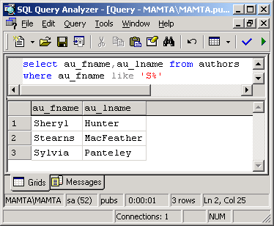
Using Wildcard characters with LIKE
Example

Slide 19
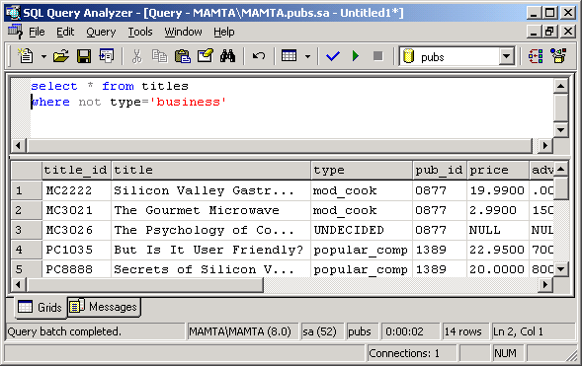
Using Logical operator NOT
Example

Slide 20
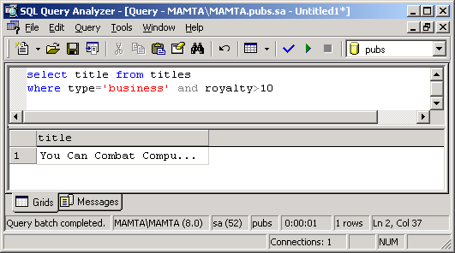
Using Logical operator AND
Example

Slide 21
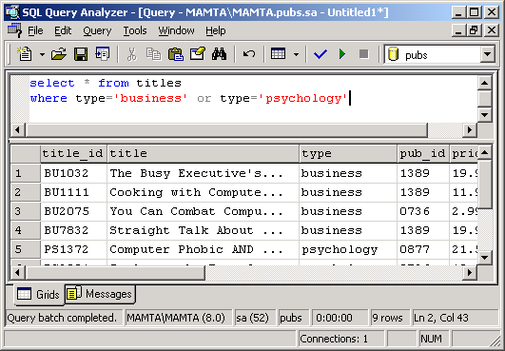
Using Logical operator OR
Example

Slide 22
ORDER BY clause
The ORDER BY clause sorts query results by one or more columns
A sort can be ascending (ASC) or descending (DESC)
By default, the records are sorted in ASC order.

Slide 23
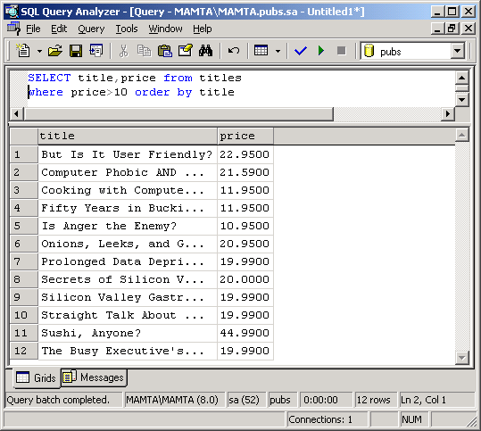
Displaying Sorted Data with SELECT and ORDER BY
Example

Slide 24
DISTINCT clause
Eliminating duplicate rows using DISTINCT with SELECT
Syntax: SELECT DISTINCT <column1> FROM <tablename>
Example: SELECT DISTINCT deptno FROM emp

Slide 25
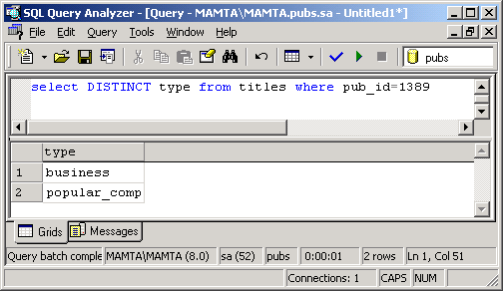
Using DISTINCT clause
Example
Each type is returned only once

Slide 26
COMPUTE clause
The COMPUTE clause generates summary values that appear as additional rows within a result set for row aggregate functions.
The summary values appear as an additional row.
The detail row and summary row can be seen within
the same result.
SYNTAX: COMPUTE <Expression1>, <Expression2>

Slide 27
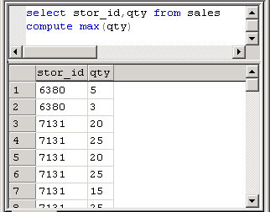
Using COMPUTE
Example

Slide 28
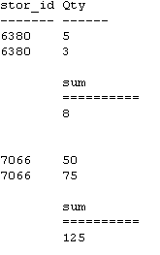
Using COMPUTE BY
If in the previous
example instead
of COMPUTE,
COMPUTE BY clause
is used then the
result will be as
shown here

Slide 29
The SELECT INTO clause
Whenever we want to create a table based on another table and populate it with a result set obtained from the existing table we make use of the SELECT INTO construct.
SELECT INTO can also be used to combine data from several different tables into one table.
Table 1
SELECT INTO
Table 2

Slide 30
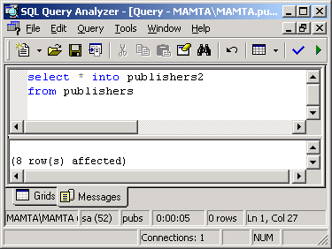
Using SELECT INTO
The example below creates a new table called
publishers2 based on the existing table publishers.
The new table will also be populated with the contents
of the publishers table.

Slide 31
Summary
A query is a question written in the Structured Query Language (SQL) to retrieve data from a table.
The SELECT statement is used for writing a query.
There are three ways to combine data from multiple tables:
  Unions - Combine rows from multiple data tables.
  Subqueries – Subquery is encapsulation of one query inside another query.
  Joins - Joins combine columns from multiple data tables.
The SQL subquery feature lets us use the results of one query as part of another query.

Slide 32
Summary Contd…
By making use of the EXISTS clause in a sub-query we can conduct an existence test for rows in a subquery.
There are two types of subqueries: Nested queries and Correlated queries
We can extend the subquery technique and have a subquery that calls another subquery. Such queries are called nested subqueries.
When a subquery takes parameters from its parent query, it is known as Correlated subquery.
Unions are used to combine rows from multiple data tables using the UNION operator of SQL.
The DISTINCT keyword eliminates duplicate rows from the resultset of a SELECT statement. If DISTINCT is not specified, all rows are returned, including duplicates.

Slide 33
Summary Contd…
The COMPUTE clause generates summary values that appear as additional rows within a result set for row aggregate functions.
COMPUTE gives the summary of the aggregate function whereas COMPUTE BY gives the summary along with the control break ups. COMPUTE BY must include ORDER BY clause.
The SELECT INTO construct helps us create and populate a new table with the data of an existing table. It performs a query based on given criteria and populates a newly created table with the resultset of that query.

